Slide 1

EXPLORATORY DATA ANALYSIS
THE NETFLIX DATASET

Slide 2
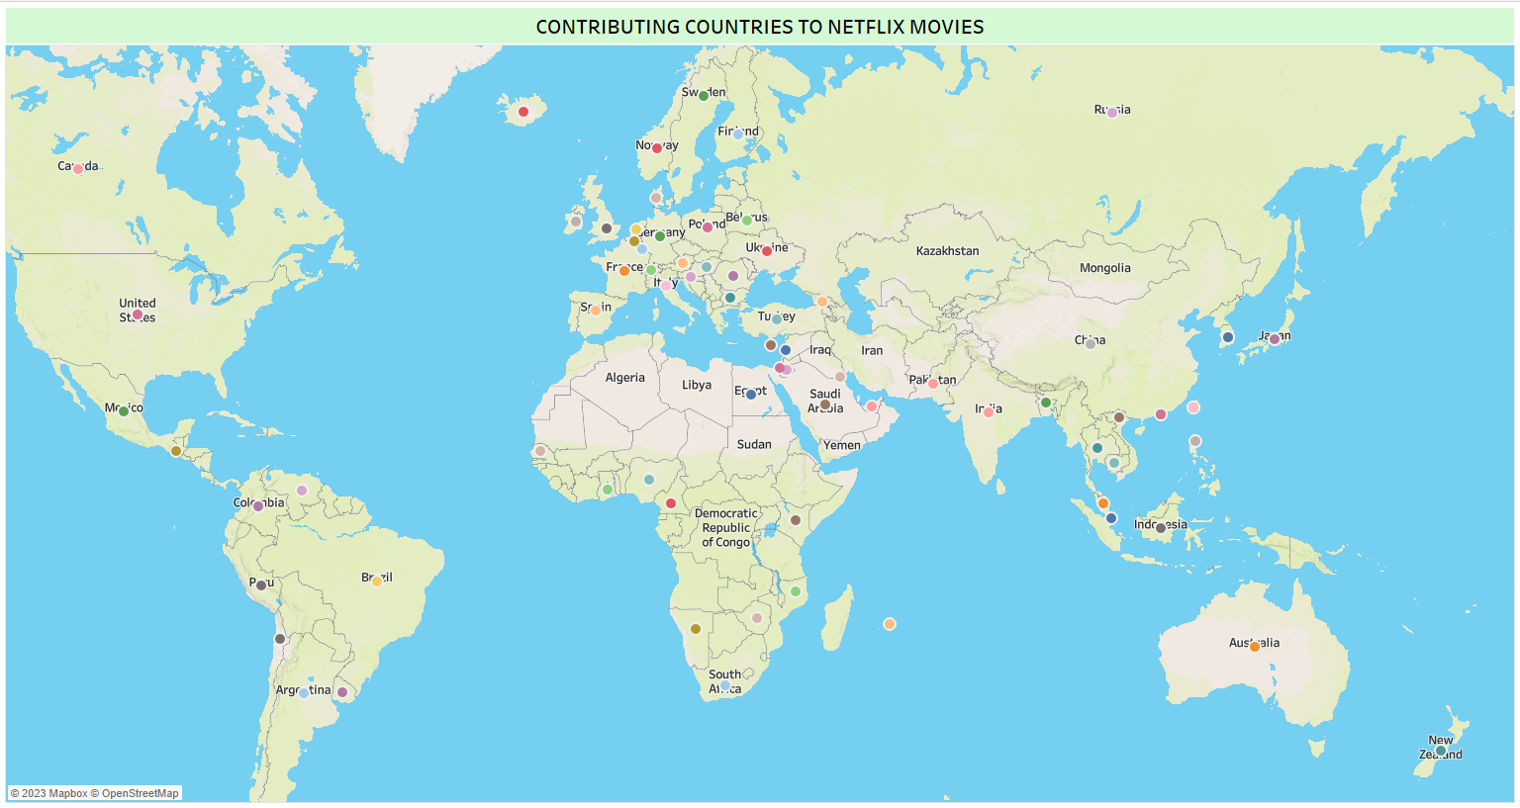
The geo-location of countries making contribution to the Netflix Dataset shows that majority of the countries are centered around Europe and Asia

Slide 3
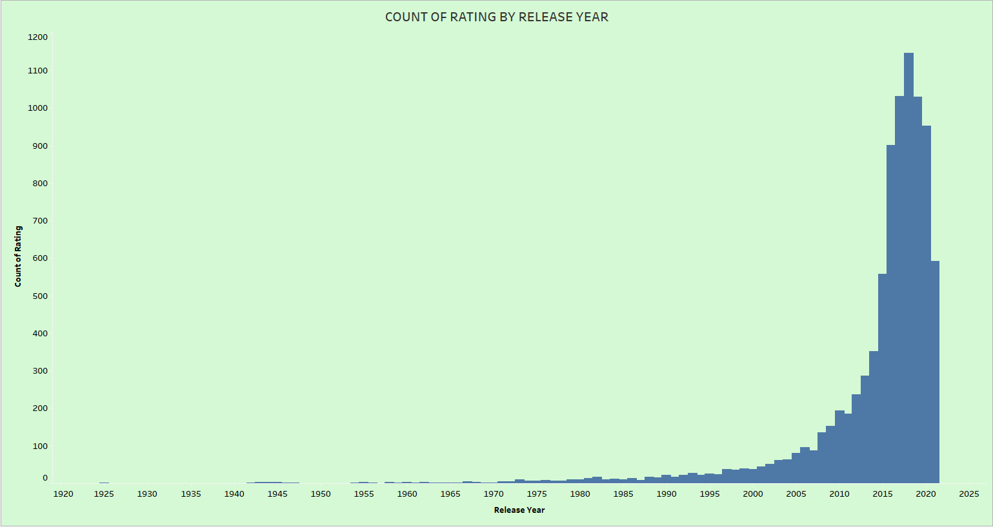
A count of the rating plotted against the release year shows that movie ratings increased dramatically from year 2005,movies got their highest ratings between 2015 and 2020

Slide 4
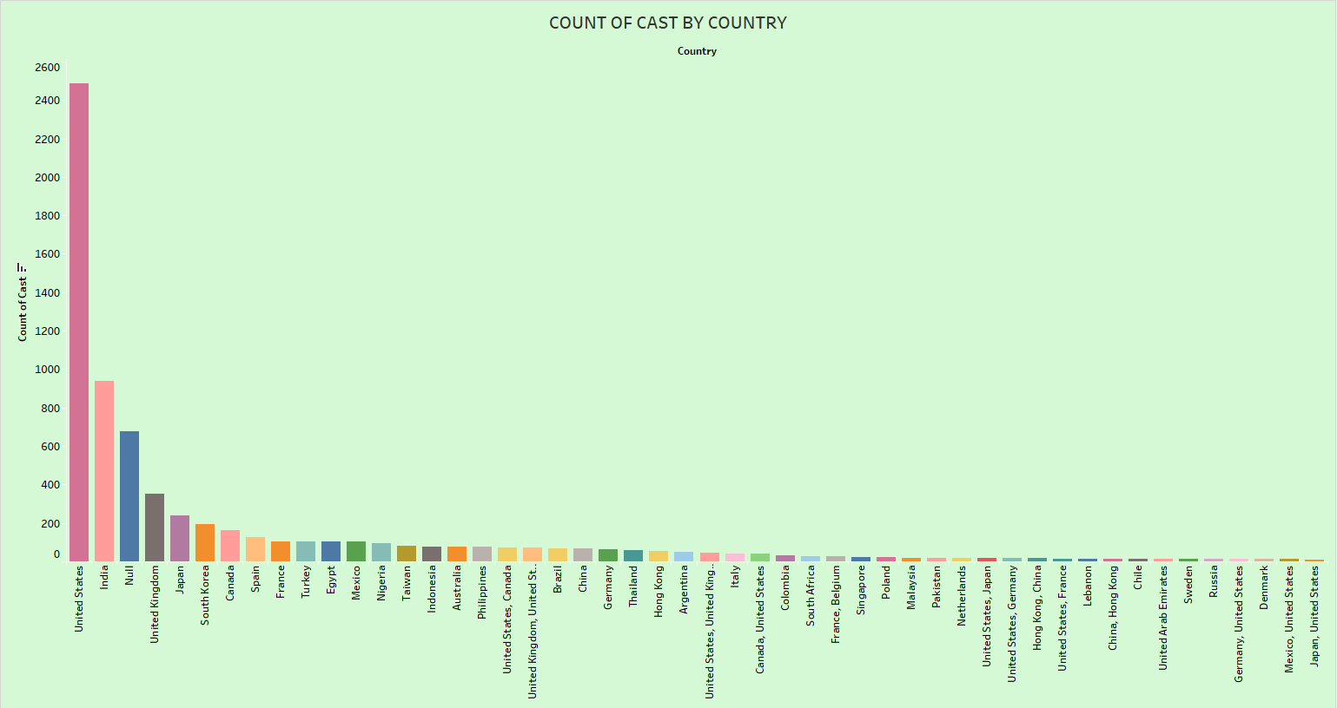
A count of cast by country shows the united States has the highest number of casts that have contents on the Netflix Network.

Slide 5
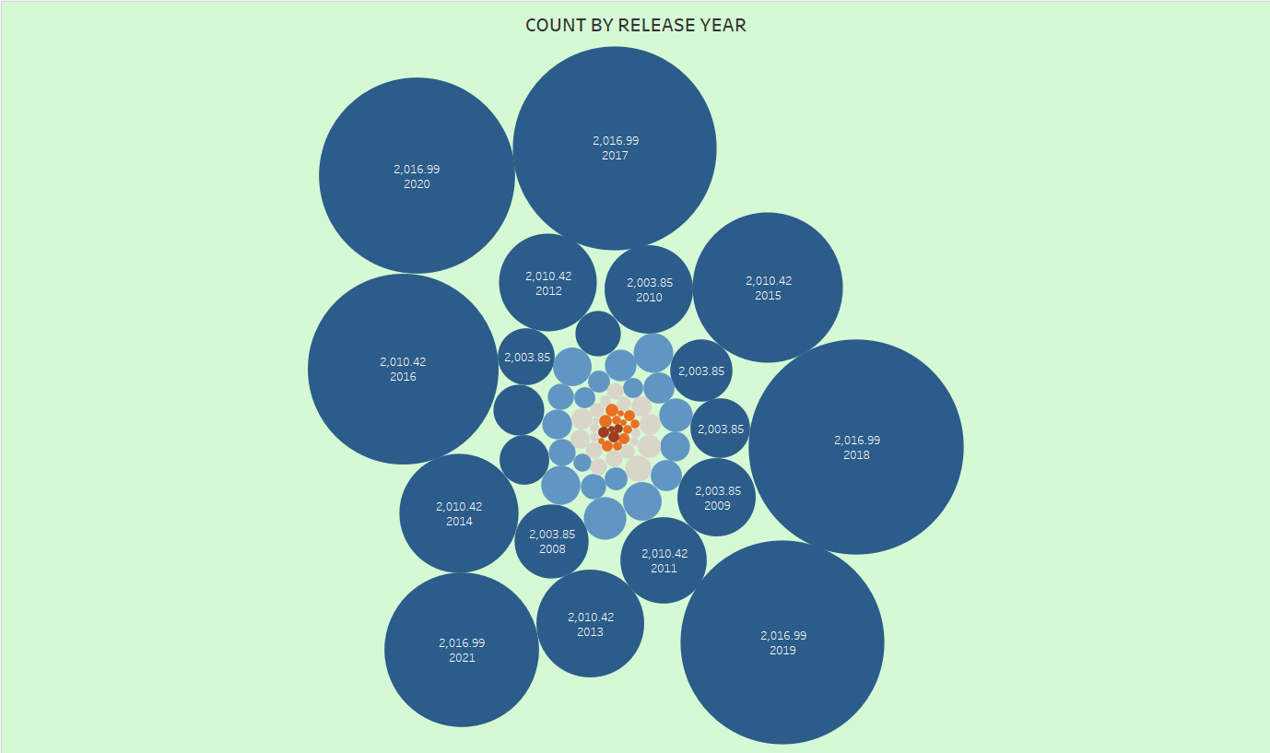
A count of movies by release year shows previous assertions that 2015 to 2022 holds the highest number of releases for movies on the Netflix Network.

Slide 6
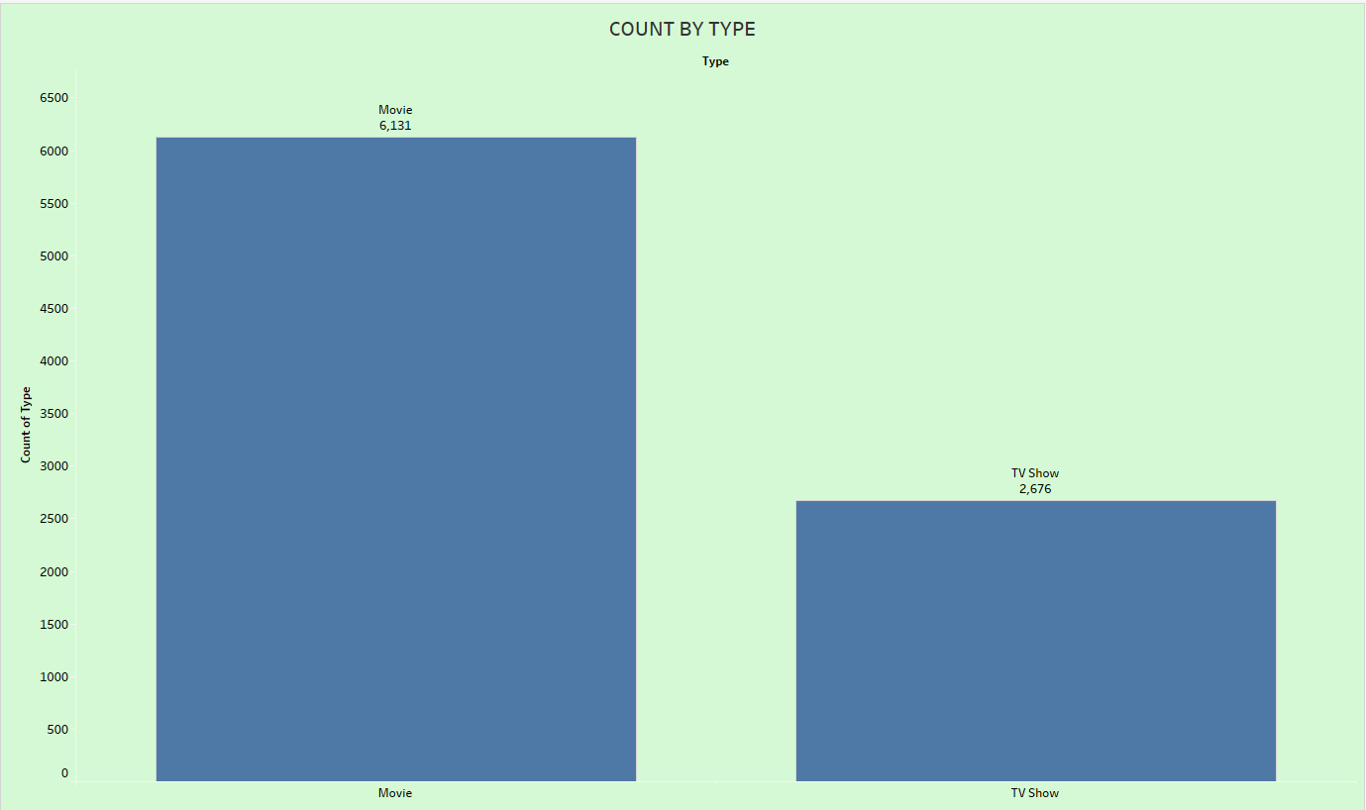
A count by type(Movies and TV-Shows) clearly shows that majority of the contents on the network are movies with over 60% of its content, with TV Shows just about 30%

Slide 7
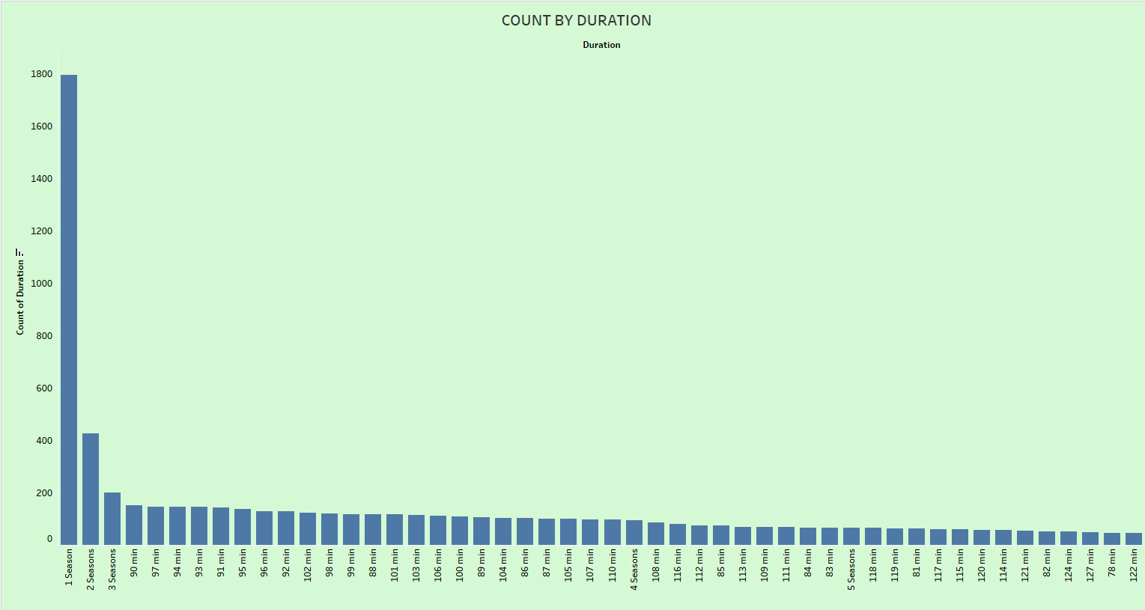
A count of movies by their duration shows that movies that have just one season are more in number followed by season two movies and then season three.

Slide 8
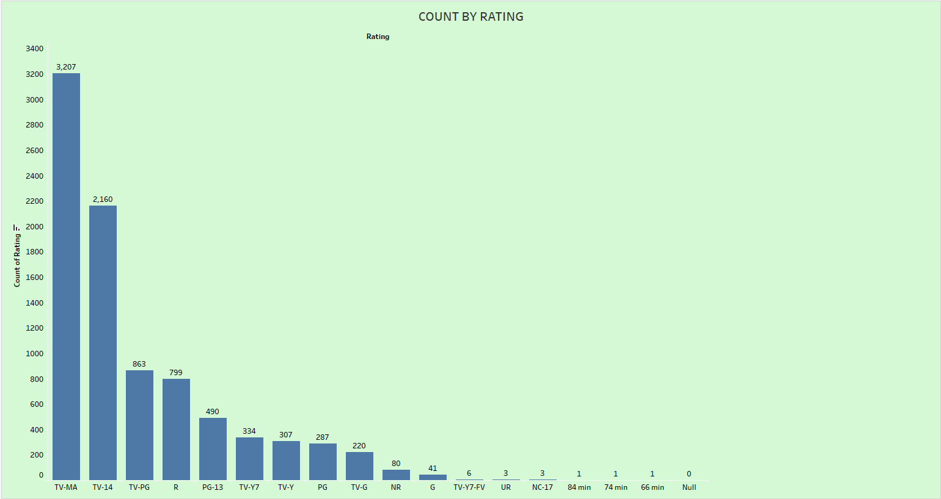
A count of TV ratings by their category shows that TV-MA(Matured Audience) has the highest count of 3,207 followed by TV-14(Not suitable for children under 14 years) with a count of 2,160 and then TV-PG(Parental Guidance) with 863 count.

Slide 9
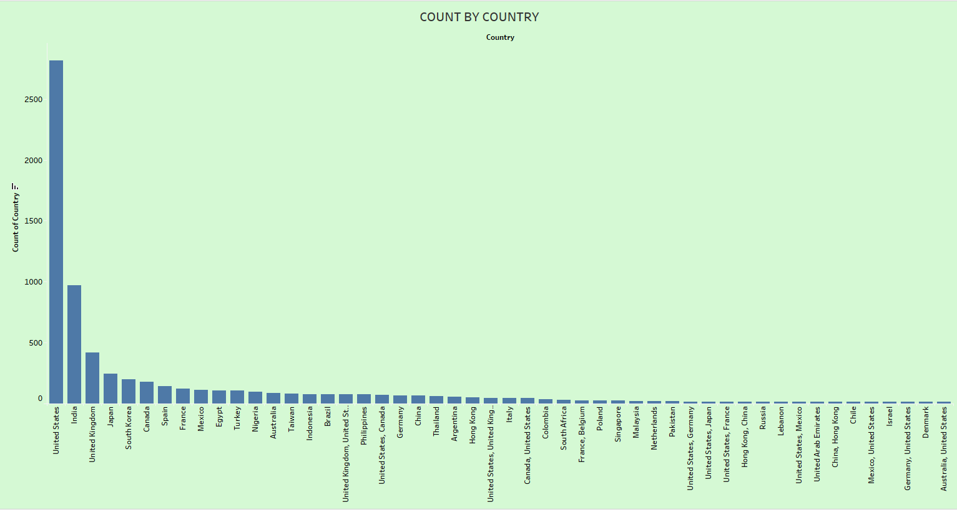
A count of movie content by country shows that the United States has the highest contribution to the Netflix network with about 3000 count.

Slide 10
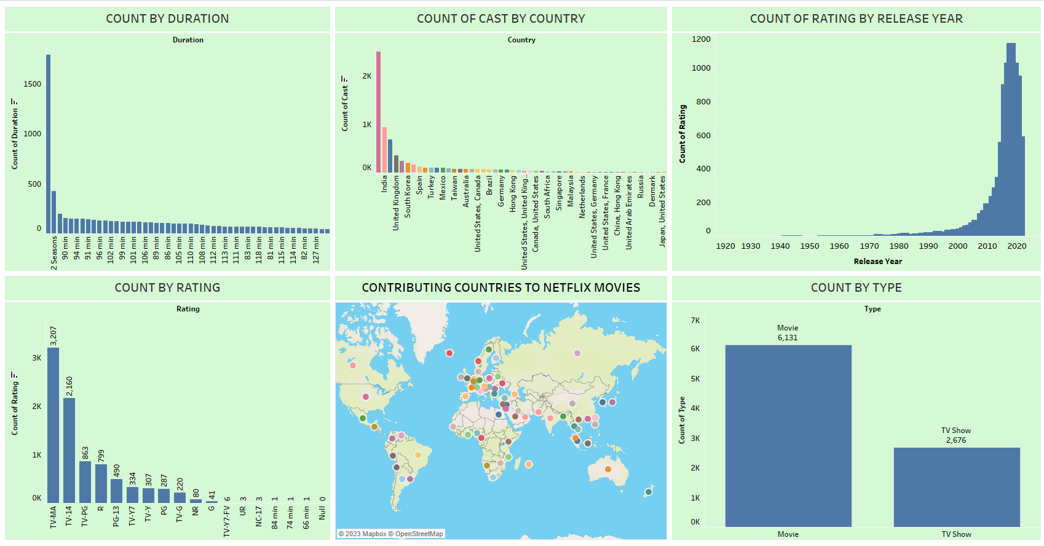
A dashboard overview of the various plots gives an overall picture of the findings so far.

Slide 11
conclusion
Majority of the countries contributing to the network are centered around Europe and Asia .
2. Movie ratings increased dramatically from year 2005,movies got their highest ratings between
2015 and 2020
3. The united States has the highest number of casts that have contents on the Netflix Network.
4. The United States has the highest contribution to the Netflix network with about 3000 count.
5. TV-MA(Matured Audience) has the highest count of 3,207 followed by TV-14(Not suitable for
children under 14 years) with a count of 2,160 and then TV-PG(Parental Guidance) with 863
count.
6. Movies that have just one season are more in number followed by season two movies and then
season three .
Majority of the contents on the network are movies with over 60% of its content, with TV Shows
just about 30% .
8. Shows previous assertions that 2015 to 2022 holds the highest number of releases for movies
on the Netflix Network.

Slide 12
recommendations
Netflix needs to diversify its content contribution base to include more contents from other continents like Africa and Latin-America, which will in-turn increase its customer and subscriber base.
Movie ratings has been seeing a steady growth since 2005, the advent of the internet and mobile TV has helped in increasing its base, this trend should be continued as it has helped in giving Network its unbeatable reach.
TV-MA(Matured Audience) followed by TV-14(Not suitable for children under 14 years) and then TV-PG(Parental Guidance). This shows that the network has a very limited number of movies and TV shows for the younger children, its highly recommended that shows that can accommodate the younger audience be encouraged or increased.
Also established is the fact that shows with only one season has the highest count, this doesn’t show a good business principle as shows ending in their first season makes it look like the Network is having so many of its shows discontinued. This aspect should be discouraged and modalities put in place to effectively check shows being put on the network to make sure it meets all viewership standards to be able to last at least three seasons.

